Slide 1

Ticket Booking System
System Analysis, Architecture, and Design

Slide 2
Team Intro
Group 10 Jatin Chopra, Anisha Agarwal, Prathik Kumar Gaddam

Slide 3
Problem Outline
To present the UML models for the Ticket Booking System.
To illustrate system design from requirements to implementation.
To ensure clarity in functional and structural aspects.

Slide 4
Project Vision- Ticket booking system
Seamless Mobile Experience – Develop a user-friendly mobile application for Flight Ticket Booking using Java, allowing users to search flights, select seats, and complete bookings effortlessly.
Scalable and Cloud-Backed Architecture – Utilize Firebase as the database to ensure real-time updates, secure data storage, and efficient performance.
Secure Transactions and Notifications – Implement robust payment processing and timely notifications to enhance user trust and system reliability.

Slide 5
Agenda
System Requirements (Use Case & Activity Diagrams)
Analysis Model (Robustness Diagram)
Architecture Model (Package & Component Diagrams)
Design Model (Class, Sequence, and State Diagrams)

Slide 6
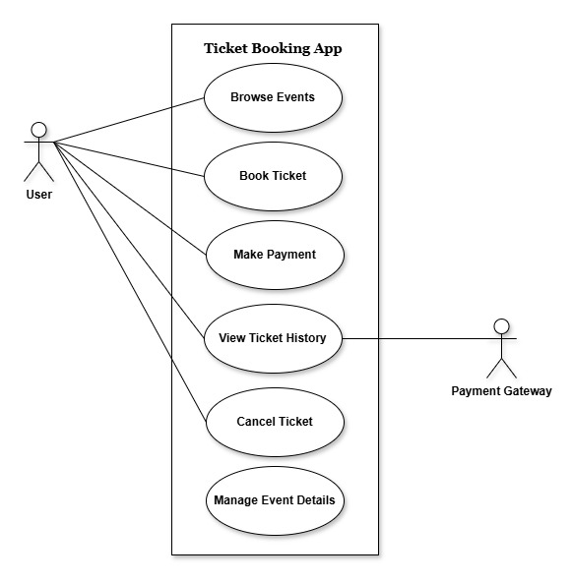
Use Case Diagram

Slide 7
Use Case Diagram
Purpose:
Defines user interactions with the system.
Identifies key actors and use cases.
Key Actors:
User → Searches flights, books tickets, and make payments.
Payment System → Processes transactions.
Notification System → Sends booking confirmations.

Slide 8
Key Use Cases
Search Flights
Select Flight & Seat
Book Ticket
Make Payment

Slide 9
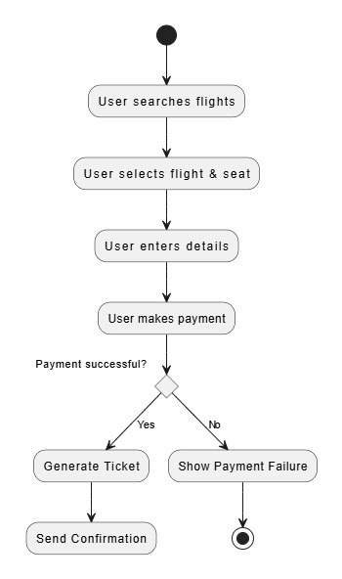
Activity Diagram - Booking Process

Slide 10
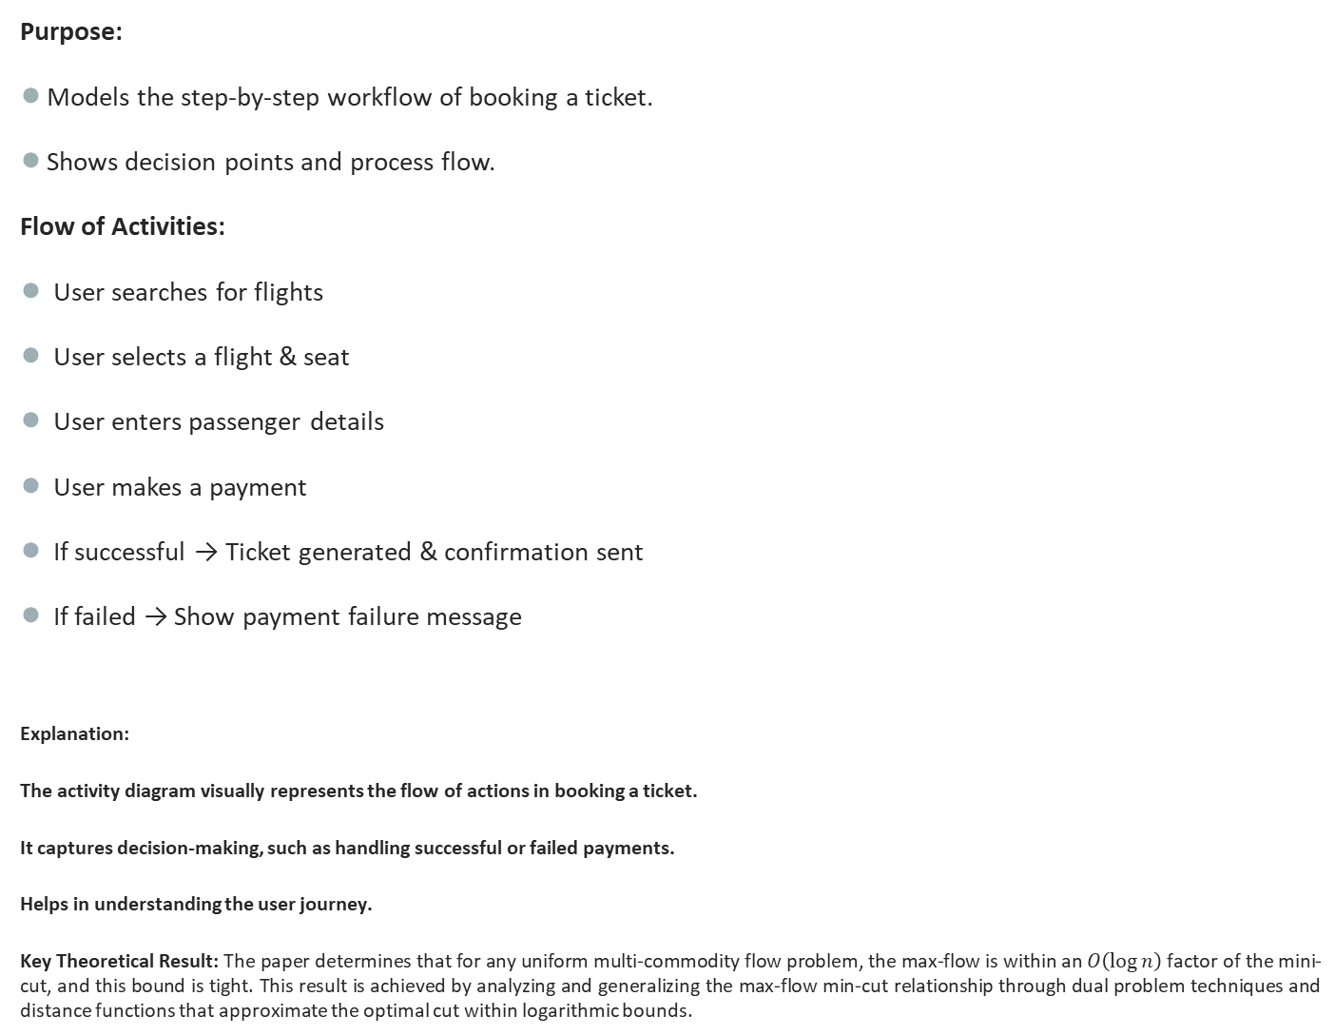
Activity Diagram - Booking Process
Purpose:
Models the step-by-step workflow of booking a ticket.
Shows decision points and process flow.
Flow of Activities:
User searches for flights
User selects a flight & seat
User enters passenger details
User makes a payment
If successful → Ticket generated & confirmation sent
If failed → Show payment failure message
Explanation:
The activity diagram visually represents the flow of actions in booking a ticket.
It captures decision-making, such as handling successful or failed payments.
Helps in understanding the user journey.
Key Theoretical Result: The paper determines that for any uniform multi-commodity flow problem, the max-flow is within an $O\left(\log{n}\right)$ factor of the mini-cut, and this bound is tight. This result is achieved by analyzing and generalizing the max-flow min-cut relationship through dual problem techniques and distance functions that approximate the optimal cut within logarithmic bounds.

Slide 11
Explanation
The activity diagram visually represents the flow of actions in booking a ticket.
It captures decision-making, such as handling successful or failed payments.
Helps in understanding the user journey.

Slide 12
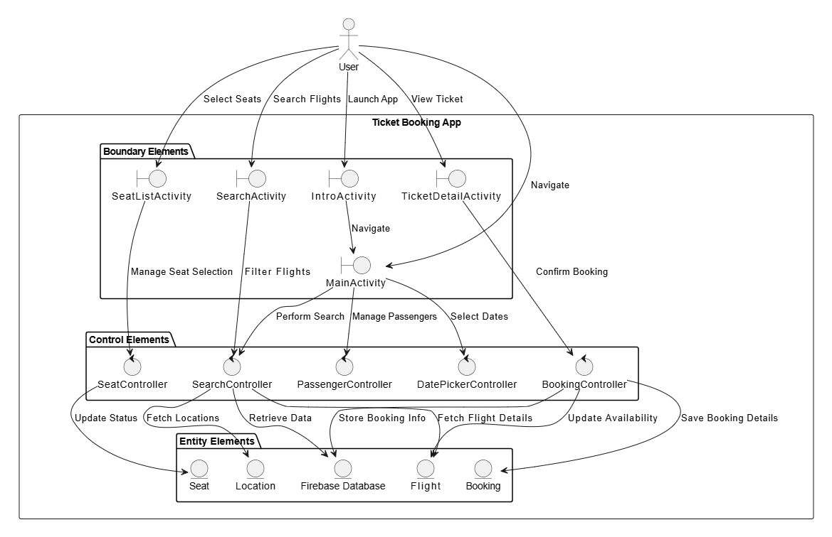
Robustness Diagram

Slide 13
Robustness Diagram
Purpose:
Bridges Use Cases and Design Models.
Identifies Boundary, Control, and Entity classes.
Key Components:
Boundary (Interface): User Interface (UI)
Control: Booking Controller (Handles logic & processing)
Entities: Flight, Ticket, Payment (Core database objects)

Slide 14
Robustness Diagram
Explanation:
Boundary classes define system interfaces (GUI, APIs).
Control classes handle business logic (e.g., processing a booking).
Entity classes represent real-world objects stored in the database.

Slide 15
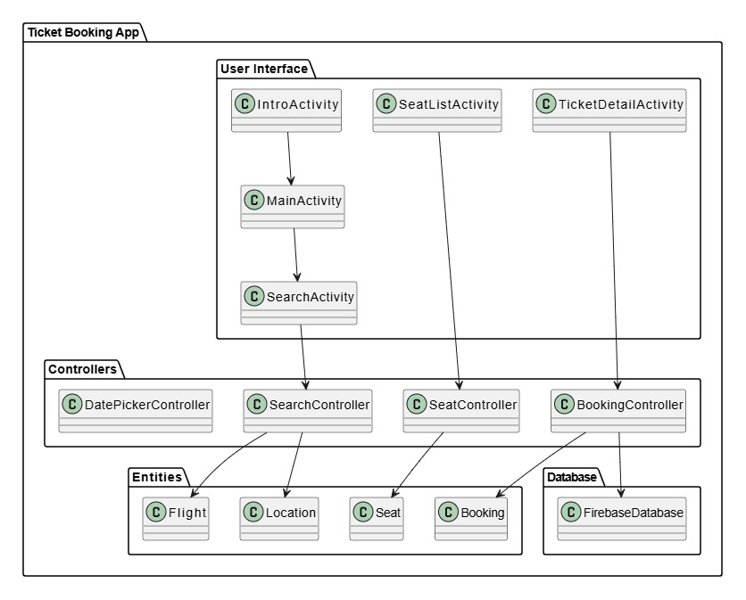
Package Diagram

Slide 16
Package Diagram
Purpose:
Organizes the system into logical groups.
Helps in modularization and code maintainability.
Main Packages:
Interface Package → Handles user interactions.
Control Package → Manages booking & payments.
Entity Package → Represents core database objects.
Relationships:
UserGUI → BookingController (Initiates booking process).
BookingController → Flight, Ticket, Payment (Handles database transactions).

Slide 17
Package Diagram
Explanation:
A package diagram helps structure the system efficiently.
Dividing the system into packages ensures better maintainability & scalability.

Slide 18
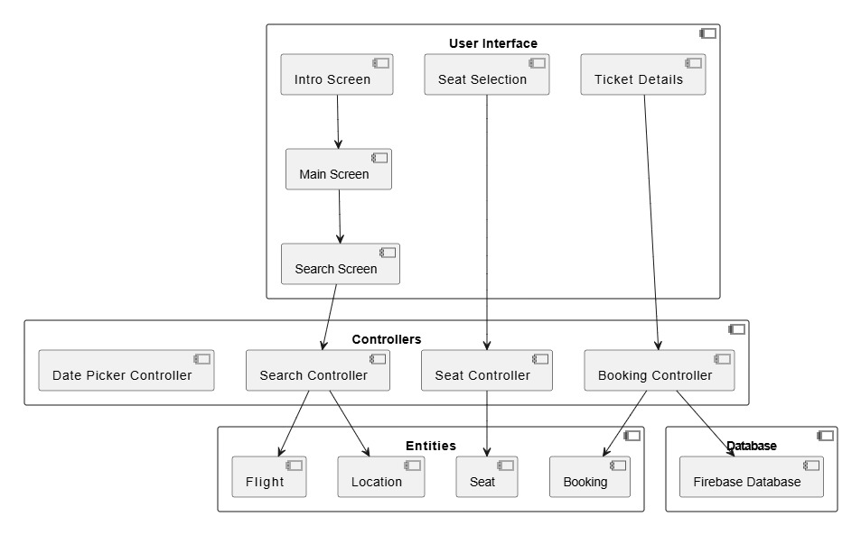
Component Diagram

Slide 19
Component Diagram
Purpose:
Shows system components and their interactions.
Represents services and external dependencies.
Main Components:
User Interface → Handles interactions.
Booking Service → Manages ticket booking.
Payment Service → Processes transactions.
Notification Service → Sends booking confirmations.
Database → Stores all booking records.

Slide 20
Component Diagram
Interactions:
User Interface → Booking Service
Booking Service → Payment Service, Notification Service, Database
Explanation:
This diagram visualizes different system components and their dependencies.
It highlights which components are responsible for which task.

Slide 21
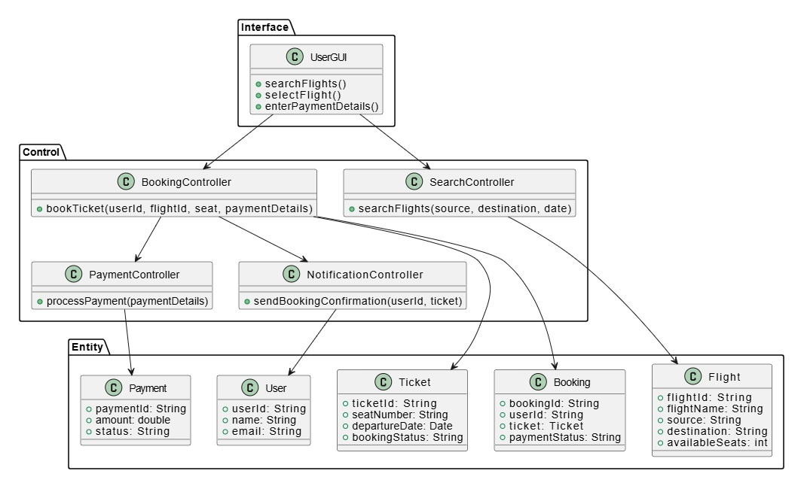
Class Diagram

Slide 22
Class Diagram
Purpose:
Represents system classes, attributes, and methods.
Shows relationships among objects.
Key Classes:
User: userId, name, email
Flight: flightId, source, destination
Ticket: ticketId, seatNumber, booking status
Booking: bookingId, userId, ticket
Relationships:
User → Booking (1-to-Many)
Booking → Ticket (1-to-1)

Slide 23
Sequence Diagram (5 use cases)
Actors & Components:
Actor: User/System Component.
Interface: GUI/API Calls.
Control: Booking/Payment Controller.
Entities: Flight, Ticket, Payment.
Use Cases Covered:
Search Flights
Select Flight & Seat
Book Ticket
Make Payment
Cancel Booking

Slide 24
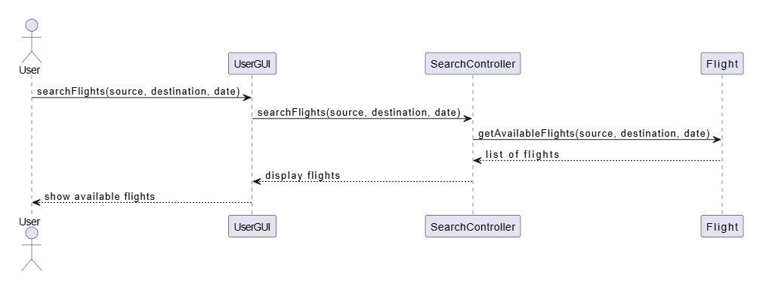
Sequence Diagram (Use case 1: Search Flight)

Slide 25
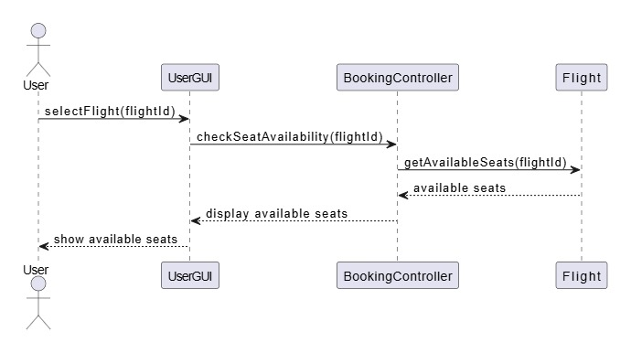
Sequence Diagram (Use case 2: Search Flight & Seats)

Slide 26
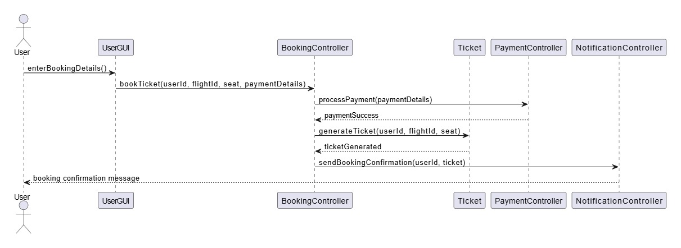
Sequence Diagram (Use case 3: Book a ticket)

Slide 27
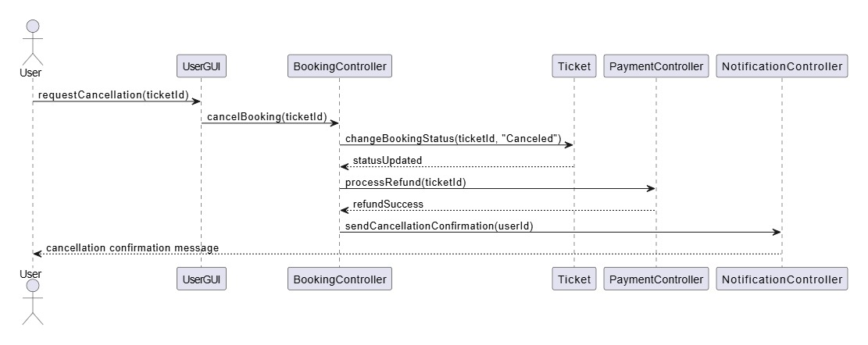
Sequence Diagram (Use case 4: Cancel a ticket)

Slide 28
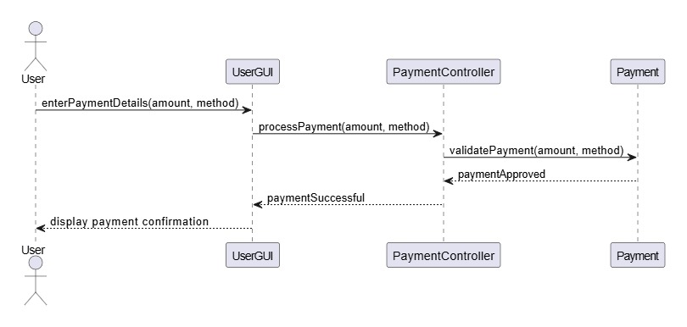
Sequence Diagram (Use case 5: Make Payment)

Slide 29
State Diagram (Booking Process)
Purpose: Represents system states and transitions.
Main States:
Searching Flights → User looks for flights.
Selecting Flight → User picks a flight & seat.
Processing Payment → Payment initiated.
Confirming Booking → Ticket is generated.
Sending Notification → Confirmation sent.
Transitions:
Selecting Flight follows Searching Flights.
Successful payment leads to Confirming Booking.

Slide 30
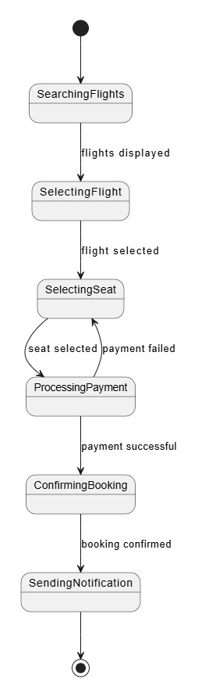
State Diagram (Booking Process)

Slide 31
Conclusion
During this presentation, we went through the UML modeling of a Ticket Booking System covering system requirements, analysis, architecture, and design models. We began by defining the functional requirements using the Use Case and Activity Diagrams that identified some of the key interactions between the system and the users. Next, the Robustness Diagram provided a bridge between system requirements and design by categorizing boundary, control, and entity classes. Second, the Architecture Model, presented as Package and Component Diagrams, depicts how different components of the system are structured and interact with each other. The system’s modular structure was presented from these diagrams, which permitted scalability, maintainability, and integration of the system.
For the Design Model, we defined the Class Diagram, emphasizing the relationships between various system objects, and Sequence Diagrams that showed the sequence of behavior for significant use cases like flight search, booking, payment processing, and cancellation. Through the integration of these UML models, we developed a well-structured and thorough base for the Ticket Booking System. Not only do these models enhance system understanding, but they also ease the development process by providing a clear blue print for implementation. In the future, these diagrams will also guide the actual development phase so that the system is user-driven while being efficient and dependable.

